Slide 1
Source: Iowa DNR Interactive Mapping

Slide 2
Land Use Challenges
Iowa ranks at the bottom of states on publicly owned land
Around 1% of total land area publicly owned (state/fed)
370,000 acres total out of over 30 million
Like some neighbors (KS, NE, IL, IN) but not others (MN, WI, MO, MI)
0.1% of original native prairie remains, very few wetlands, forests
Environmental consequences for this loss of habitat and land
A lot of conservation land is privately owned. Ex:1.7 million acres in CRP program
Iowa not in a position to lose any, but now trying to add conservation land (Ex: I-WILL)
Notes:
Balance:
Initial good overlap of windy areas to working lands, less windy areas to sensitive lands.
Benefits to Iowa to achieving high wind goals – jobs, GHG reductions
Unchecked climate change will harm Iowa’s habitat and ecosystems
All of these can help justify what local impacts do occur from big expansion of wind and transmission

Slide 3
Iowa Opportunities
Over 90% of Iowa land now is in production agriculture, working lands
Current use matches well with an expansion of wind and transmission
Economic benefits from wind expansion
Environmental benefits from more wind – avoid climate change impacts, other pollution

Slide 4
Source: Iowa GAP Analysis

Slide 6
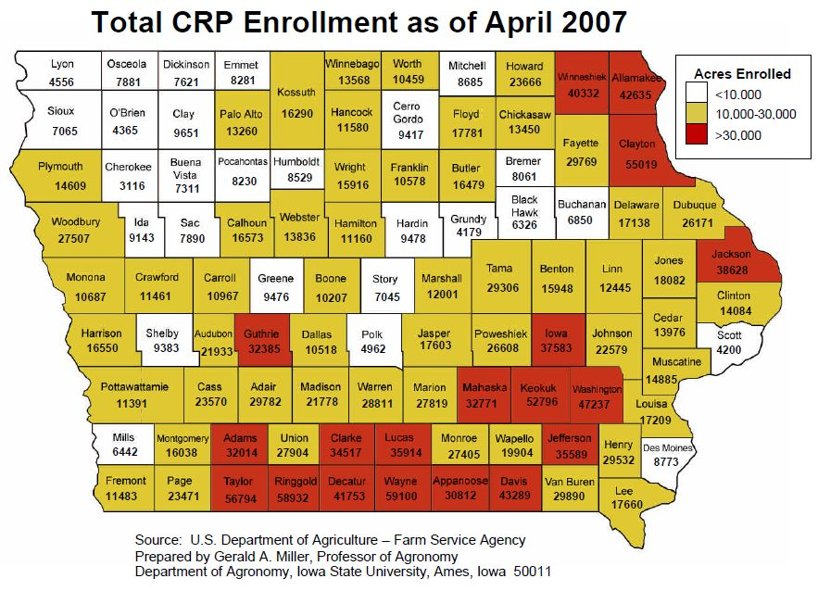

Slide 7
Iowa Wind Goals
Nearly 4,000 MW installed today
About 20% of all generation
20,000 MW an approximate total long term goal
Iowa’s share in DOE 20% wind by 2030 report
Iowa one of exporting states
Consistent with other exports in our economy
Will need transmission to get to 20,000 MW

Slide 8
Iowa Wind Benefits
Jobs & economic benefits from 20,000 MW
63,000 shorter-term jobs in construction phase
9,000 permanent jobs
Annual property tax revenue of $89.6M
Annual land lease payments of $53M
Source: Center for Rural Affairs, Governor’s Wind Energy Coalition, NREL
Environmental
ICCAC: 10 GW wind in 2020, plus other renewables = 33 MMT GHG reduced annually to help mitigate climate change
Transmission a means to attain these benefits
Not if, but when and how

Slide 9
Climate Impacts for Iowa
“Native species are very likely to face increasing threats from rapidly changing climate conditions, pests, diseases, and invasive species moving in from warmer regions.”
“All major groups of animals including birds, mammals, amphibians, reptiles, and insects will be affected by climate change impacts on local populations …”
Source: U.S. Global Change Research Program

Slide 10
Issues going forward
Are we preserving our small amount of habitat and conservation land?
Public land – almost none
Private land – CRP, conservation easements, etc.
Maximizing use of existing routes, easements
Focusing wind & transmission build out on working lands and developed areas, away from most sensitive areas
Are we getting the wind benefits & significantly reducing pollution & GHGs?
Is the transmission primarily bringing on wind?
Are we actually helping to avoid climate impacts?
Are we maximizing additional clean energy strategies?
Energy efficiency, distributed generation

Slide 11
Source: Iowa DNR Interactive Mapping

Slide 12
77.2(1) Endangered animal species: Mammals Indiana Bat Plains Pocket Mouse Red-backed Vole Spotted Skunk Birds Red-shouldered Hawk Northern Harrier Piping Plover Common Barn Owl Least Tern King Rail Short-eared Owl Fish Lake Sturgeon Pallid Sturgeon Pugnose Shiner Weed Shiner Pearl Dace Freckled Madtom Bluntnose Darter Least Darter Reptiles Yellow Mud Turtle Wood Turtle Great Plains Skink Copperbelly Water Snake Western Hognose Snake Copperhead Prairie Rattlesnake Massasauga Rattlesnake Amphibians Blue-spotted Salamander Crawfish Frog Butterflies Dakota Skipper Ringlet Land Snails Iowa Pleistocene Snail Minnesota Pleistocene Ambersnail Iowa Pleistocene Ambersnail Frigid Ambersnail Briarton Pleistocene Vertigo Bluff Vertigo Iowa Pleistocene Vertigo Fresh Water Mussels Spectacle Case Slippershell Buckhorn Ozark Pigtoe Bullhead Ohio River Pigtoe Slough Sandshell Yellow Sandshell Higgin’s-eye Pearly Mussel 77.2(2) Threatened animal species: Mammals Least Shrew Southern Bog Lemming Birds Long-eared Owl Henslow’s Sparrow Fish Chestnut Lamprey American Brook Lamprey Grass Pickerel Blacknose Shiner Topeka Shiner Western Sand Darter Black Redhorse Burbot Orangethroat Darter Reptiles Slender Glass Lizard Common Musk Turtle Blanding’s Turtle Ornate Box Turtle Diamondback Water Snake Western Worm Snake Speckled Kingsnake Amphibians Mudpuppy Central Newt Butterflies Powesheik Skipperling Byssus Skipper Mulberry Wing Silvery Blue Baltimore Snails Midwest Pleistocene Vertigo Occult Vertigo Fresh Water Mussels Cylinder Strange Floater Creek Heelsplitter Purple Pimpleback Butterfly Ellipse 77.2(3) Special concern animal species: Mammals Southern Flying Squirrel Birds Forster's Tern Black Tern Peregrine Falcon Bald Eagle Fish Pugnose Minnow Pirate Perch Reptiles Smooth Green Snake Bullsnake Butterflies Dreamy Duskywing Sleepy Duskywing Columbine Duskywing Wild Indigo Duskywing Ottoe Skipper Leonardus Skipper Pawnee Skipper Beardgrass Skipper Zabulon Skipper Broad-winged Skipper Sedge Skipper Two-spotted Skipper Dusted Skipper Salt-and-pepper Skipper Pipevine Swallowtail Zebra Swallowtail Olympia White Purplish Copper Acadian Hairstreak Edward’s Hairstreak Hickory Hairstreak Striped Hairstreak Swamp Metalmark Regal Fritillary Baltimore
Endangered plant species: COMMON NAME Pale false foxglove Blue giant-hyssop Bearberry Black chokeberry Eared milkweed Mead’s milkweed Narrow-leaved milkweed Ricebutton aster Large-leaved aster Schreber’s aster Fern-leaved false foxglove Matricary grape fern Poppy mallow Cordroot sedge Large-bracted corydalis Silky prairie-clover Swamp-loosestrife Northern panic-grass Roundleaved sundew False mermaid Bog bedstraw Povertygrass Northern St. Johnswort Pineweed Winterberry Black-based quillwort Water-willow Dwarf dandelion Cleft conobea Whiskbroom parsley Running clubmoss Bog clubmoss Annual skeletonweed Water marigold Northern lungwort Bigroot pricklypear Clustered broomrape Ricegrass Cinnamon fern Purple cliffbrake Arrow arum Pale green orchid Eastern prairie fringed orchid Clammyweed Crossleaf milkwort Purple milkwort Jointweed Douglas’ knotweed Three-toothed cinquefoil Canada plum Frenchgrass Pink shinleaf Prickly rose Meadow spikemoss Rough-leaved goldenrod Bog goldenrod Yellow-lipped ladies-tresses Pickering morning-glory Rough-seeded fameflower Waxy meadowrue Long beechfern Large-leaved violet Rusty woodsia Yellow-eyed grass 77.3(2) Threatened plant species: Northern wild monkshood Round-stemmed false foxglove Nodding wild onion Fragrant false indigo Virginia snakeroot Woolly milkweed Showy milkweed Forked aster Rush aster Flax-leaved aster Water parsnip Kittentails Bog birch Pagoda plant Leathery grapefern Little grapefern Sweet Indian-plantain Poppy mallow Pipsissewa Golden saxifrage Dayflower Spotted coralroot Bunchberry Golden corydalis Pink corydalis Showy lady’s-slipper Slim-leaved panic-grass Jeweled shooting star Glandular wood fern Marginal shield fern Woodland horsetail Slender cottongrass Yellow trout lily Queen of the prairie Blue ash Black huckleberry Oak fern Green violet Twinleaf Creeping juniper Intermediate pinweed Hairy pinweed Prairie bush clover Twinflower Western parsley Wild lupine Tree clubmoss Rock clubmoss Hairy waterclover Bog buckbean Winged monkeyflower Yellow monkeyflower Partridge berry Pinesap Small sundrops Little pricklypear Royal fern Philadelphia panic-grass Slender beardtongue Hooker’s orchid Northern bog orchid Western prairie fringed orchid Purple fringed orchid Pink milkwort Silverweed Shrubby cinquefoil Pennsylvania cinquefoil One-sided shinleaf Meadow beauty Beaked rush Northern currant Shining willow Bog willow Low nutrush Buffaloberry Scarlet globemallow Slender ladies-tresses Oval ladies-tresses Hooded ladies-tresses Spring ladies-tresses Rosy twisted-stalk Fameflower Large arrowgrass Small arrowgrass Low sweet blueberry Velvetleaf blueberry False hellebore Kidney-leaved violet Oregon woodsia 77.3(3) Special concern plant species: Balsam fir Three-seeded mercury Three-seeded mercury Mountain maple Moschatel Water plantain Wild onion Amaranth Lanceleaf ragweed Saskatoon serviceberry Low serviceberry Raccoon grape Pearly everlasting Sand bluestem Broomsedge Purple angelica Purple rockcress Green rockcress Lakecress Fringed sagewort Common mugwort Pawpaw Curved aster Hairy aster Prairie aster Standing milkvetch Bent milkvetch Missouri milkvetch Blue wild indigo Yellow wild indigo Prairie moonwort Watershield Buffalograss Poppy mallow Water-starwort Grass pink Low bindweed Clustered sedge Back’s sedge Bush’s sedge Carey’s sedge Flowerhead sedge Field sedge Crawe’s sedge Fringed sedge Double sedge Douglas’ sedge Dry sedge Thin sedge Delicate sedge Mud sedge Hoplike sedge Yellow sedge Intermediate sedge Backward sedge Richardson’s sedge Rocky Mountain sedge Sterile sedge Soft sedge Deep green sedge Tuckerman’s sedge Umbrella sedge Wild oats Pink turtlehead Fogg’s goosefoot Missouri goosefoot Coast blite Bugbane Hill’s thistle Swamp thistle Wavy-leaved thistle Western clematis Blue-eyed Mary Cancer-root Fireberry hawthorn Red hawthorn Two-fruited hawthorn Hawthorn Hawksbeard Prairie tea Crotonopsis Waxweed Dodder Small white lady’s-slipper Carolina larkspur Sessile-Johnswort Eared

